Slide 1
Direct Energy Amplified Threat Hunting System for Targeting Asteroids and Rocks
William, Eric, Jeff, Wei

Slide 2
DEATHSTAR
William, Eric, Jeff, Wei

Slide 3
KPPs
Success rate: 98%
Leakage rate: 0.01%
Mission availability: 95% over two week period
Notes:
A mission success rate of 98%
The acceptable leakge rate for impacts is 0.01%
Provide a 98% reliability of threat mitigation.
Launch system is expected to fly a sortie rate of once a month
Once the on-orbit system reaches initial operational capability, it must be replenished to the IOC leavel after any engagement within two weeks
(surge capability) The mission availability rate must be no less than 85%, and must be as high as 95% over any two week period

Slide 4
Mission Analysis (Analysis of Alternatives – AOA)
What is needed
Detect, intercept and mitigate asteroids.
List Options considered
Ground based (GB) laser (DEATHSTAR)
Space based (SB) laser
Lunar based (LB) laser
Notes:
No launch cost,

Slide 5
Mission Analysis (Analysis of Alternatives – AOA)
 | GB Laser | SB Laser | LB Laser
Cost | Low | Medium | High
Schedule | Best | Medium | Worst
Performance | Worst | Medium | Best
Notes:
No launch cost,

Slide 6
Mission Analysis (Analysis of Alternatives – AOA)
Recommended Option (DEATHSTAR)
Lowest cost
Quickest response
Easily expandable and maintainable
Notes:
No launch cost,
Lowest cost of all considered solutions
Quickest initial response
Easily expandable and maintainable.

Slide 7
Architecture (OV-1)
CONOPS:
8 sites – Florida, Alaska, North Pole, Russia, Japan, Australia, Antarctica and Panama.
Global coverage
15 years of operational readiness
International partner interfaces
24 hour MTTF
Existing satellite detects/ communicates incoming threat to ground system
Earth
DEATH STAR
Ground
Sites
Coverage provided
by ground system
Communication to Ground site
Satellite detection

Slide 8
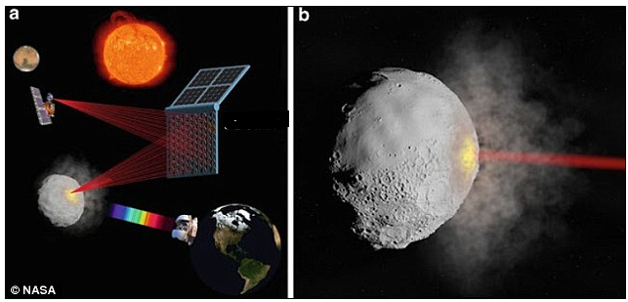
Architecture (OV-1)
Zhang, Walish, and Melis

Slide 9
Technology Needs
Tech Readiness (TRL) 1-3
Technology | Level 0-1 | Level 1-2 | Level 2-3
Direct energy apparatus |  |  | Currently 3
Competitive Phase A leading to multiple technology demonstration prior to Milestone B.
Tech Readiness (TRL) 4-7
Technology | Level 4-5 | Level 6-7 | Level 7
Direct energy apparatus |  |  | Post DT Phase 7
Notes:
Solicit multiple contracts and down select two which can lead to

Slide 10
Program Proposal (Acquisition Strategy – Full Program)
Initiate Technology development and demonstration
Award study contracts that result in technological demonstration in a relevant environment (TRL5).
Down select to two prototypes.
Prototype demonstration in a space environment (TRL 7)
Select one system to be built
PDR, CDR, T&E, LRP, OT&E, FRP, Deployment, sustainment, IOC, FOC

Slide 11
Full Program Proposed Life Cycle and Budget (Program Objective Memorandum – POM)
Tech development
Prototype
EMD
Production
IOC – CONUS
FOC – Global
Notes:
3021 for space procurement
30

Slide 12
References
What is a Learning Curve? James R. Martin, PhD
Affordable Spacecraft: Design and Launch Alternatives, Jan 1990.
Orbital Simulations on Deflecting Near-earth Objects by Directed Energy, Qicheng Zhang, Kevin J Walsh, Carl Melis, 2016.
Notes:
3021 for space procurement
30

